Slide 1
Deep Learning for Natural Language Processing Lecture 2: Deep Neural Networks and Word Embedding
Quan Thanh Tho
Faculty of Computer Science and Engineering
Ho Chi Minh City University of Technology

Slide 2
Acknowledgement
Some slides are from Coursera course of Prof. Andrew Ng.

Slide 3
Agenda
Intuition of Neural Network for Classification Task
Neural Network and Deep NN Text Classification
Specific DNN Architecture: CNN and AutoEncoder
From AutoEncoder to Word Embedding
Doc2vec: combining tf.idf and WE

Slide 4
Classical Machine Learning Techniques for NLP
Machine Learning Task
The tf.idf weights
Neural-based approach

Slide 5
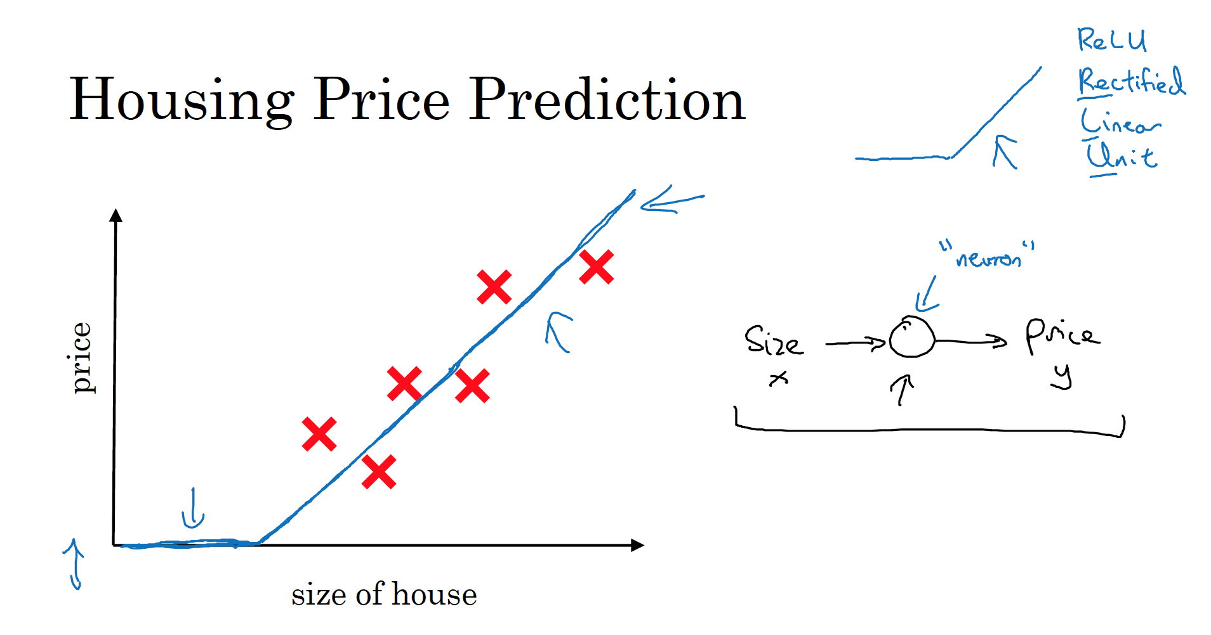

Slide 6
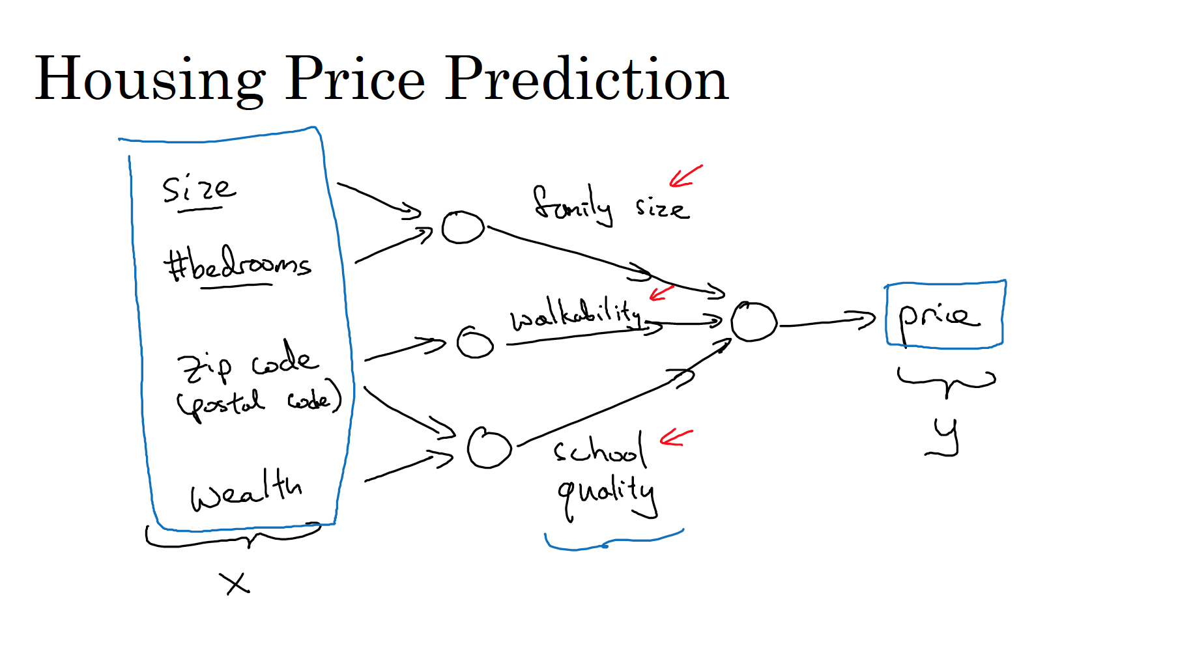

Slide 7
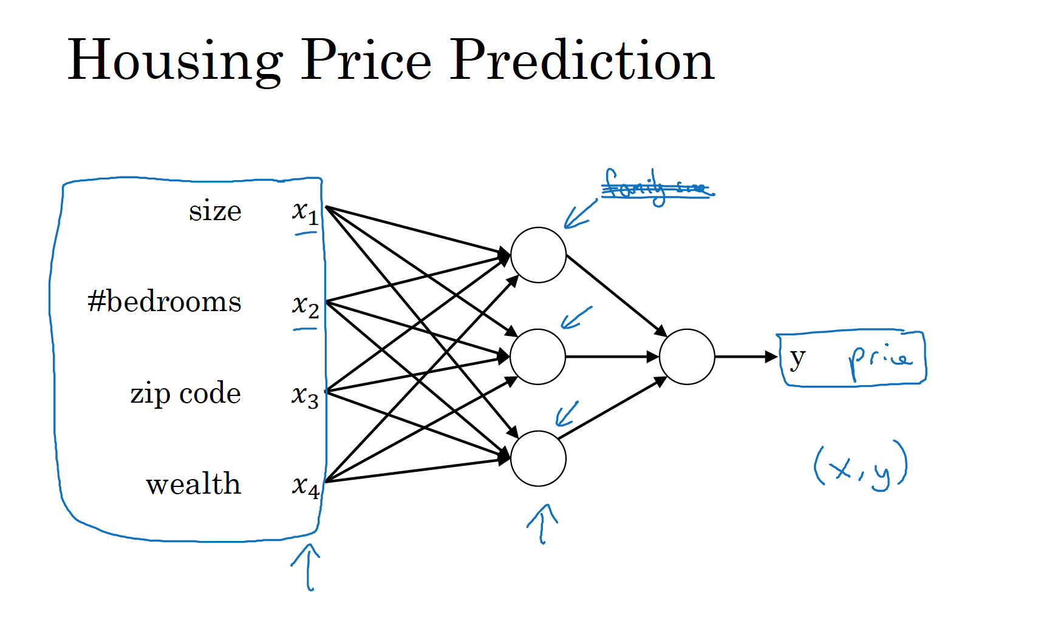

Slide 8
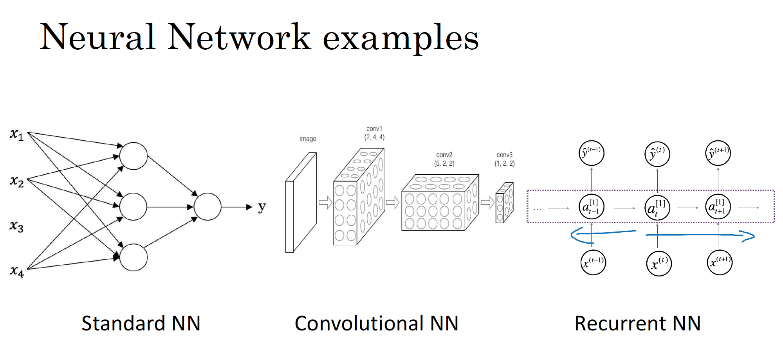

Slide 9
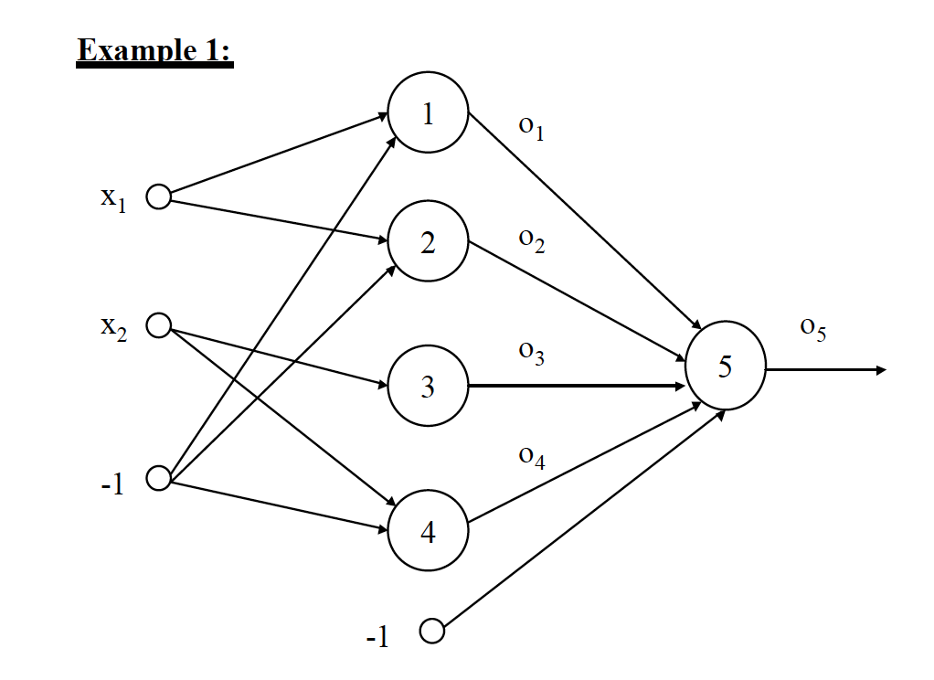
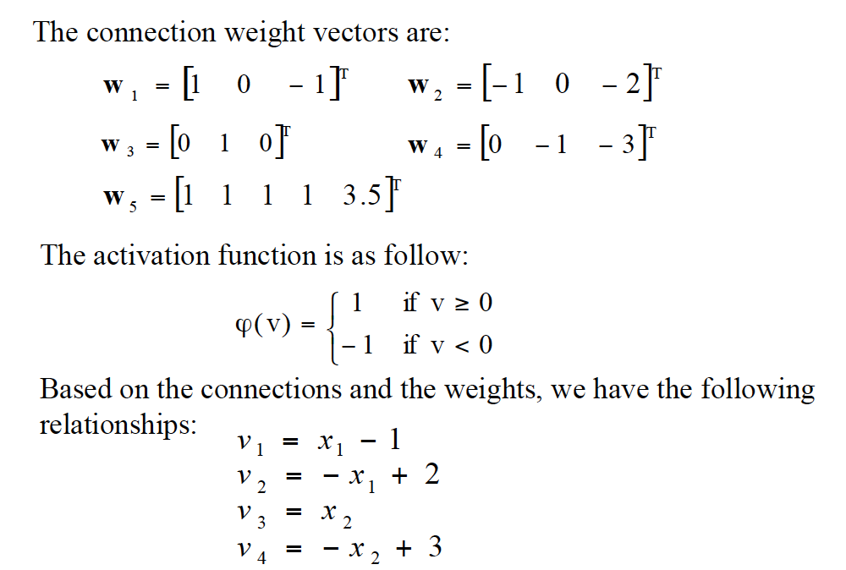

Slide 10
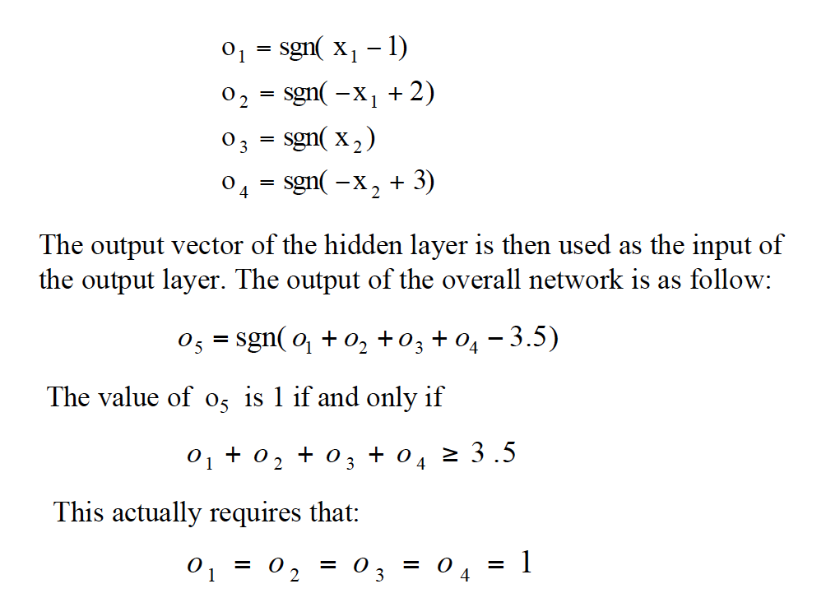

Slide 11
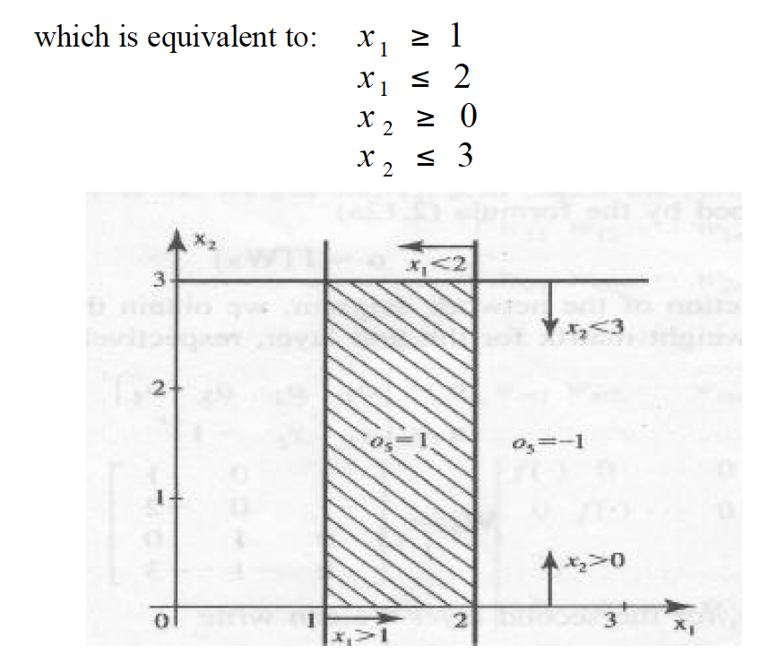

Slide 12
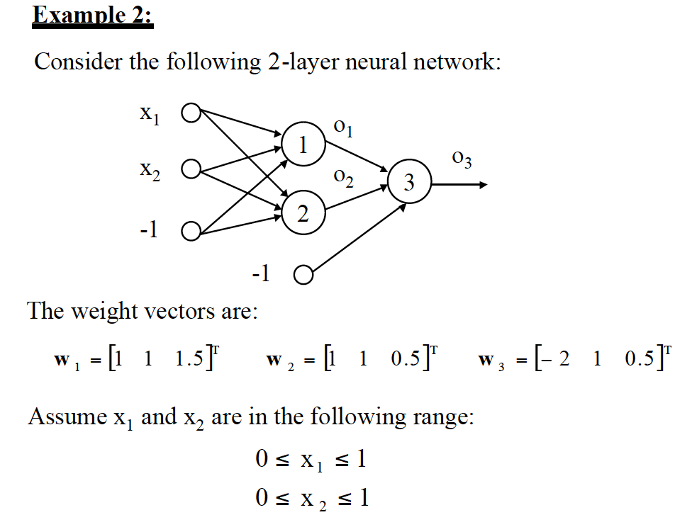
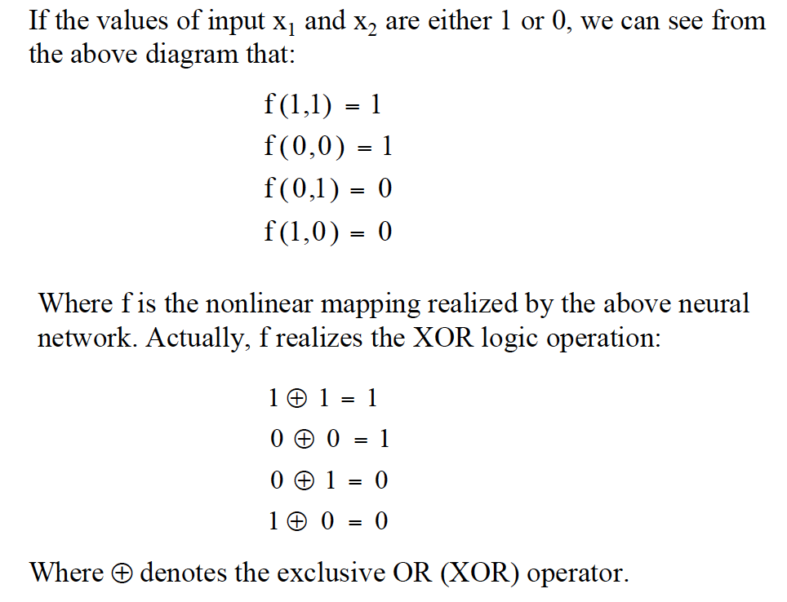
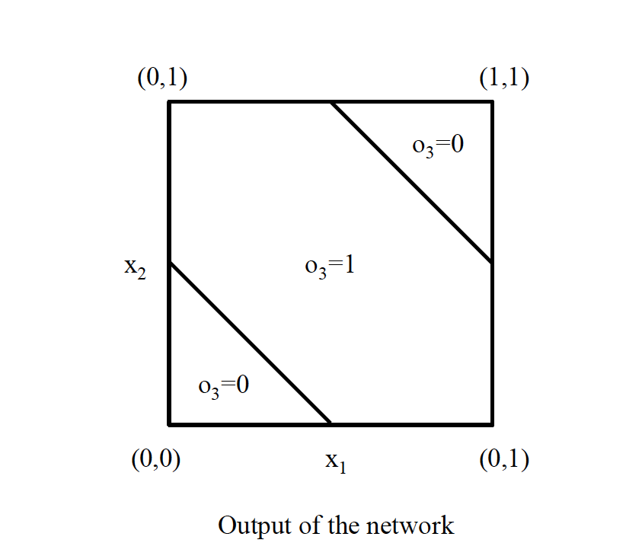

Slide 13
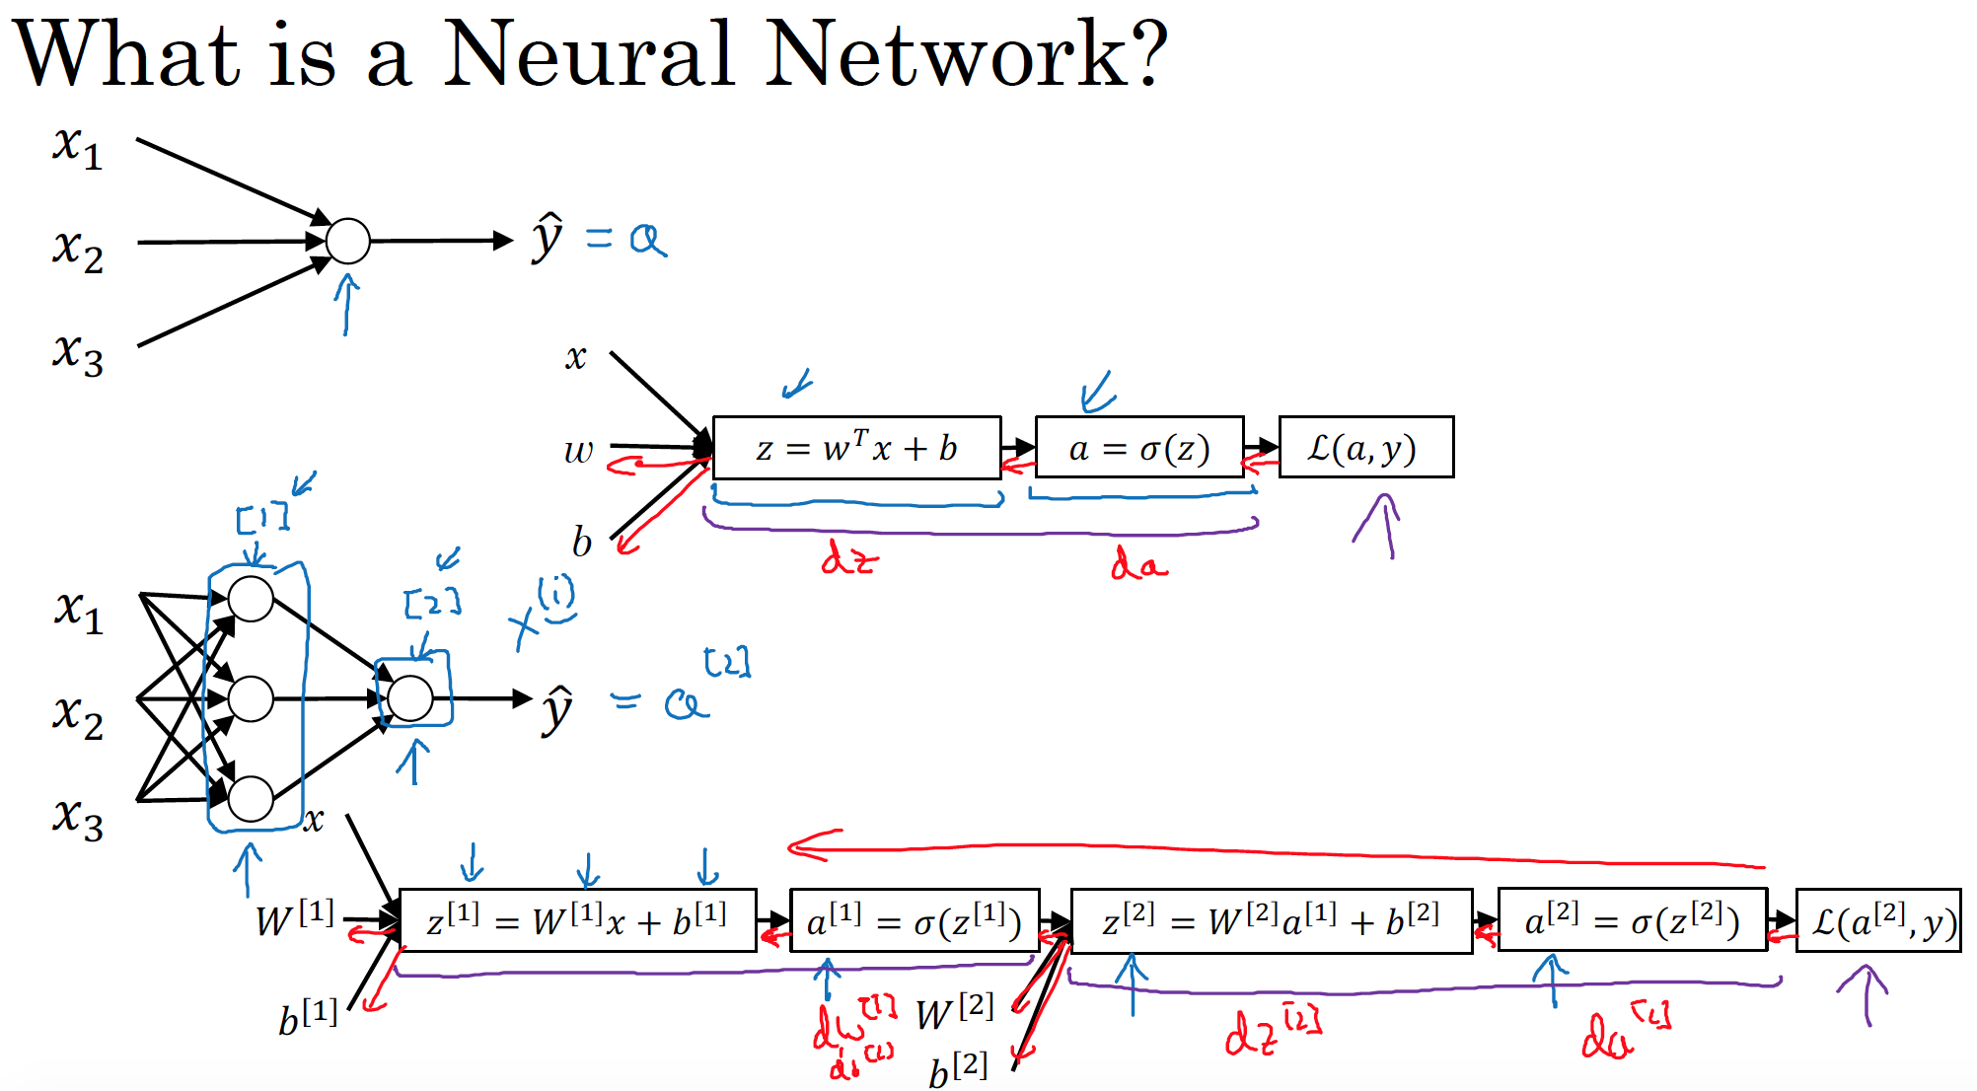

Slide 14
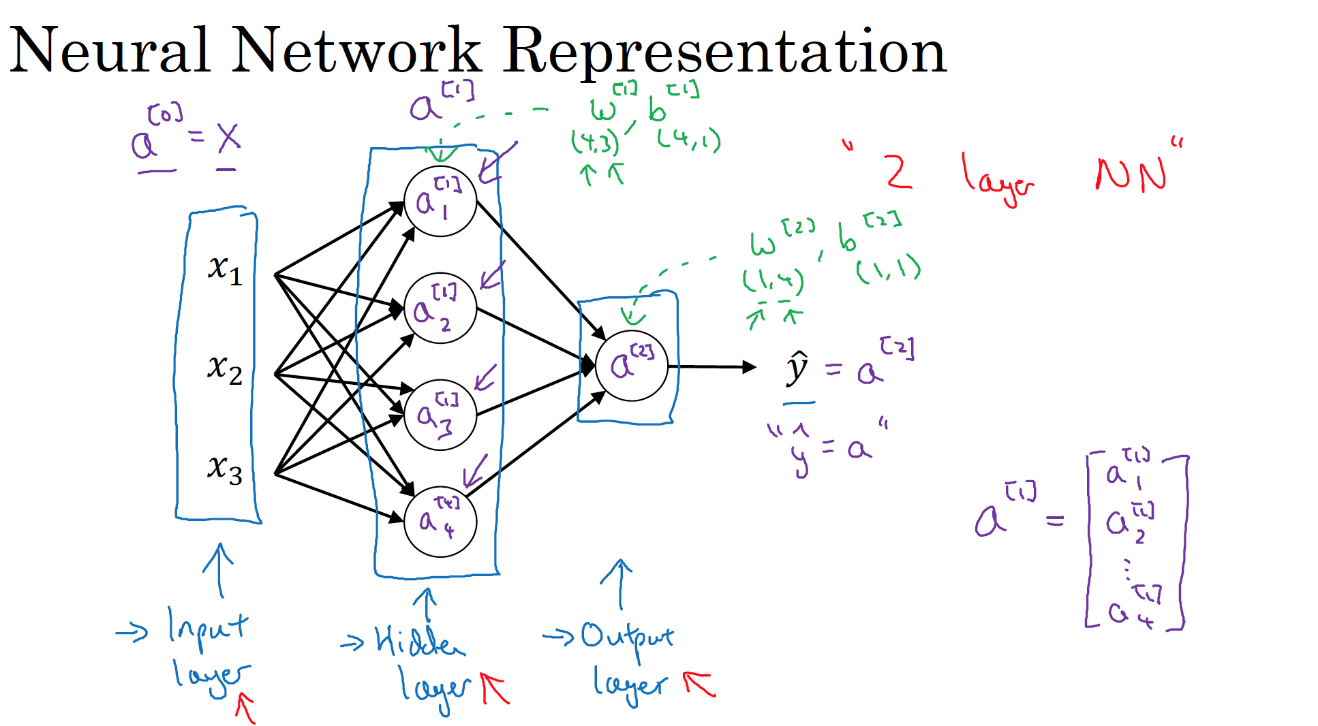

Slide 15
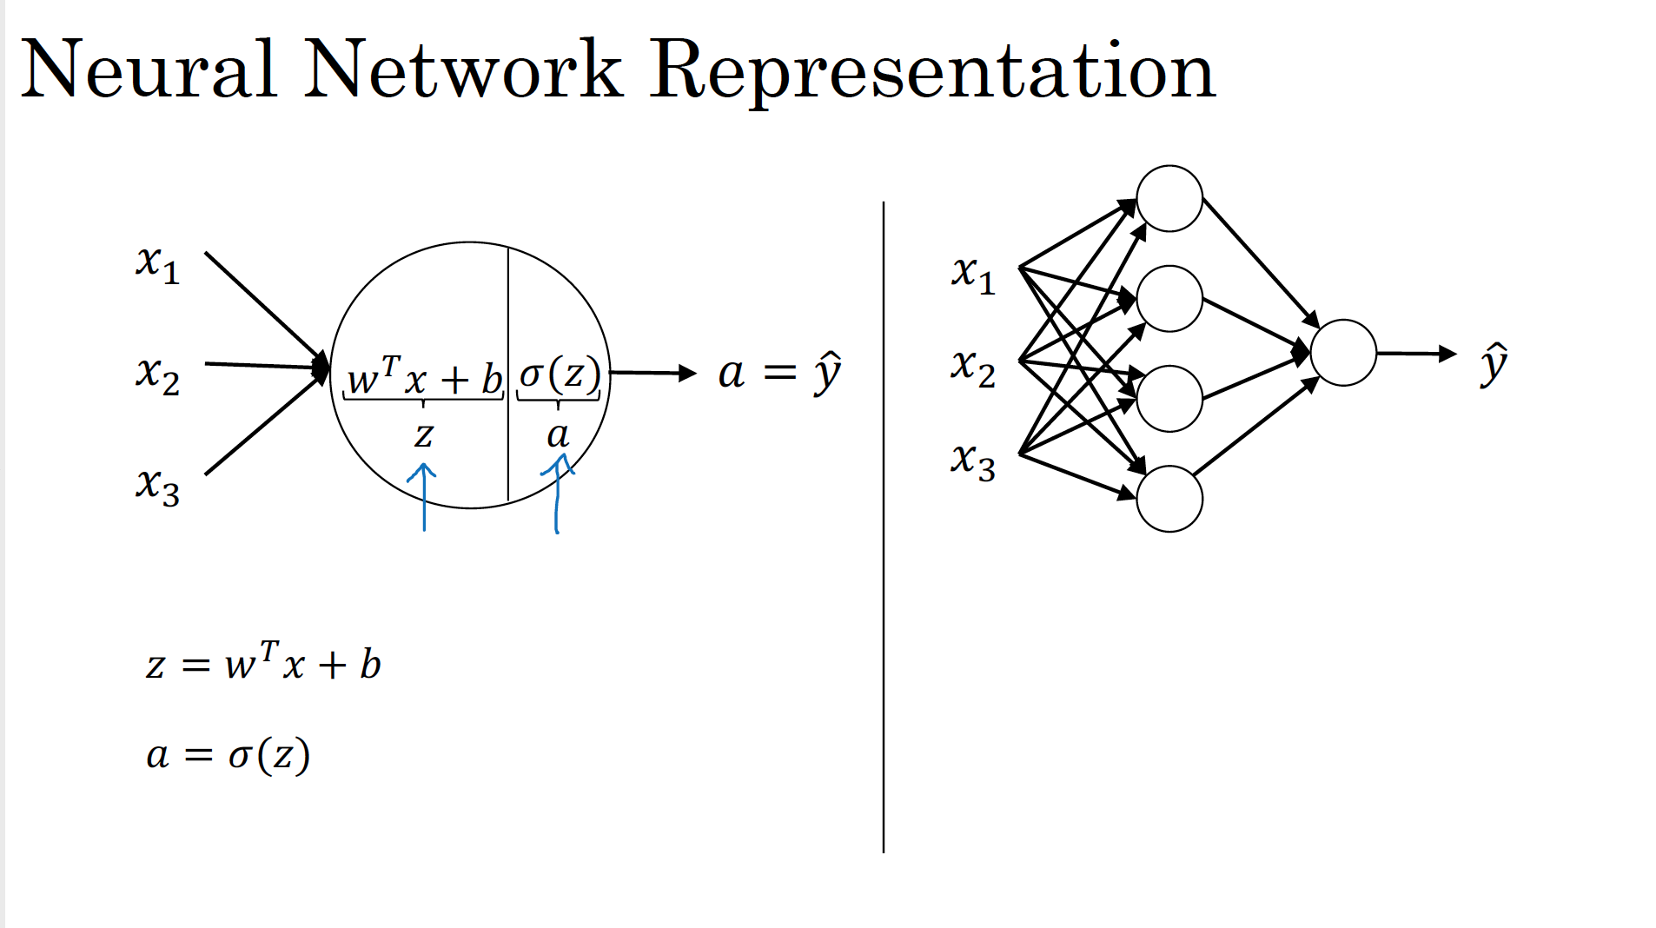

Slide 16
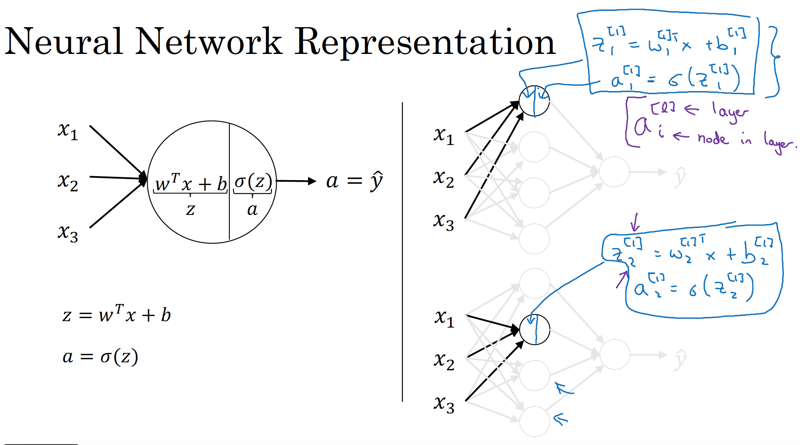

Slide 17
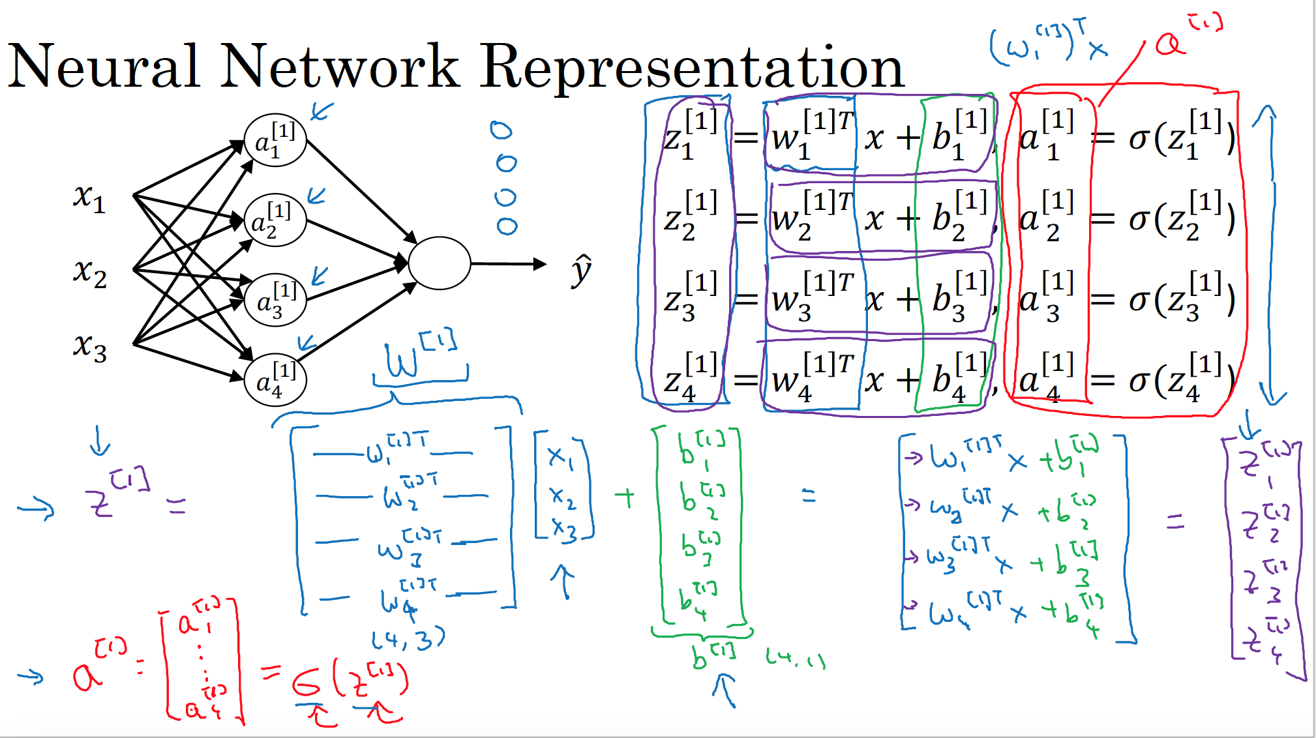

Slide 18
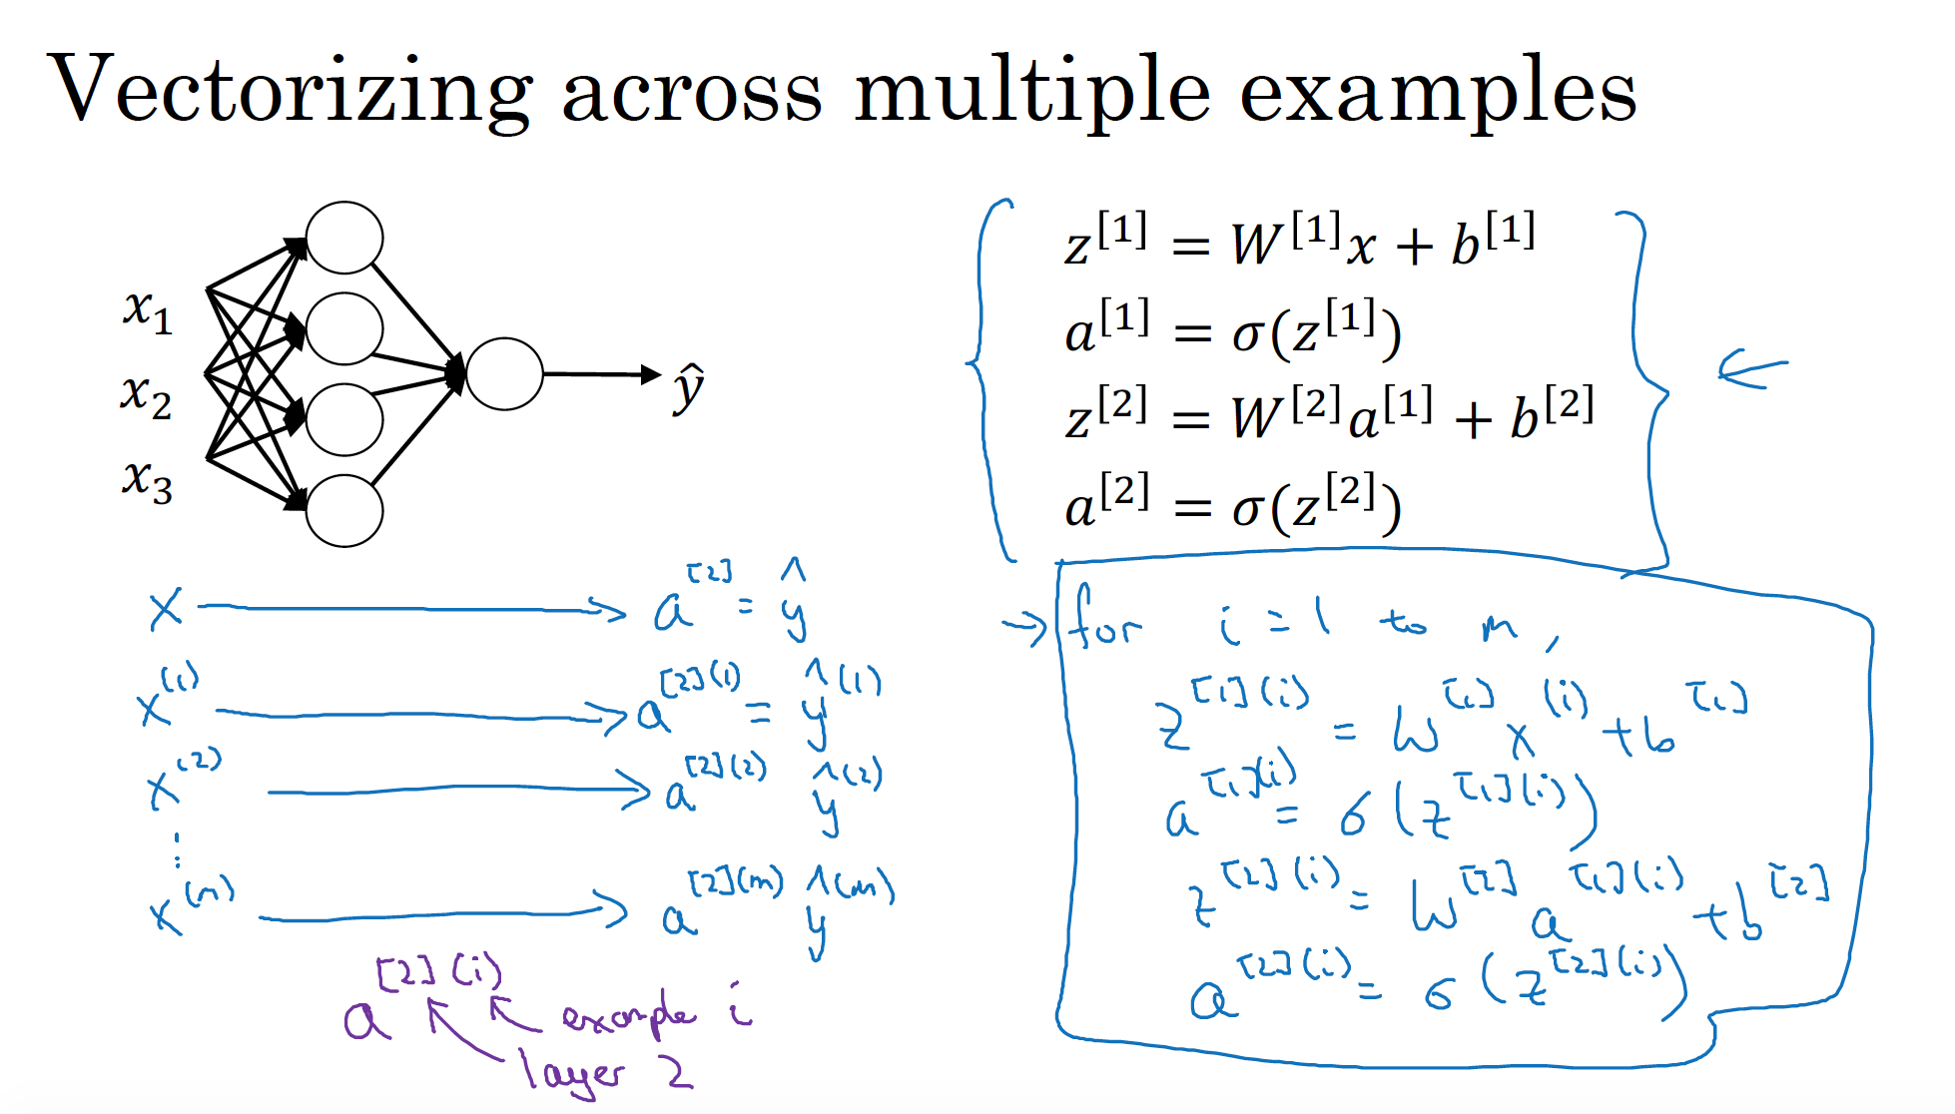

Slide 19
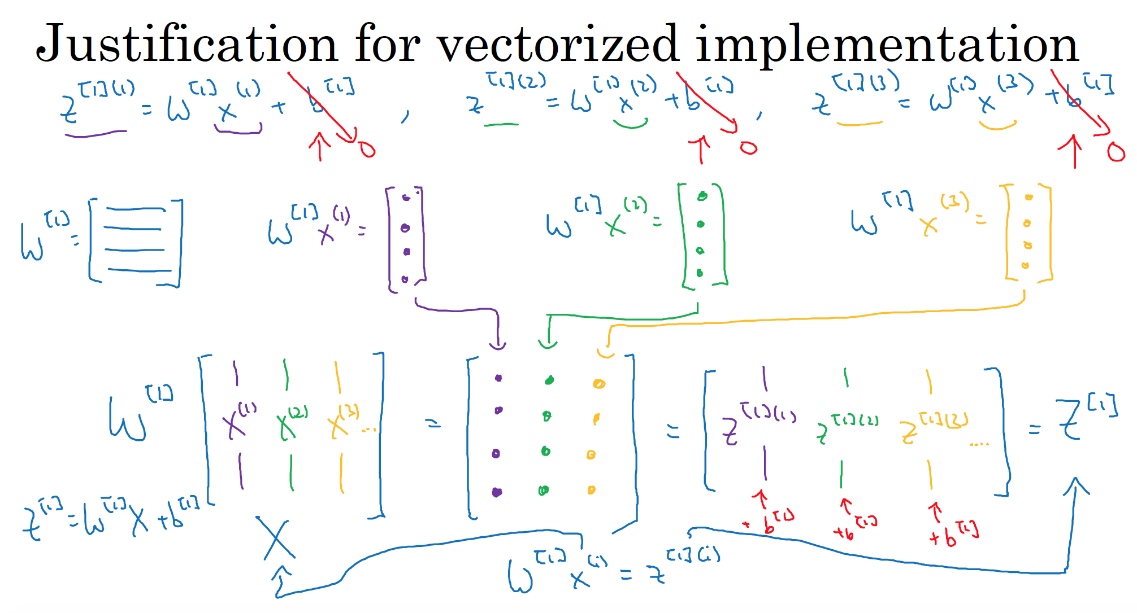

Slide 20
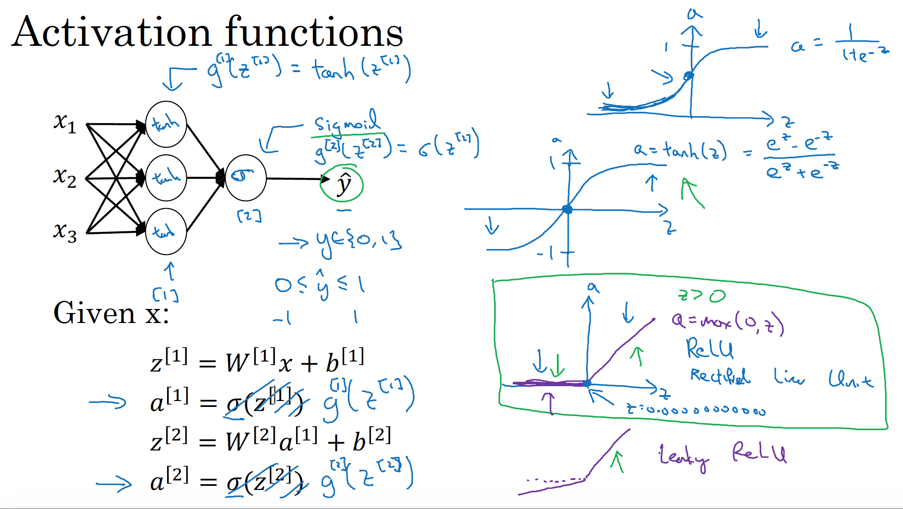

Slide 21
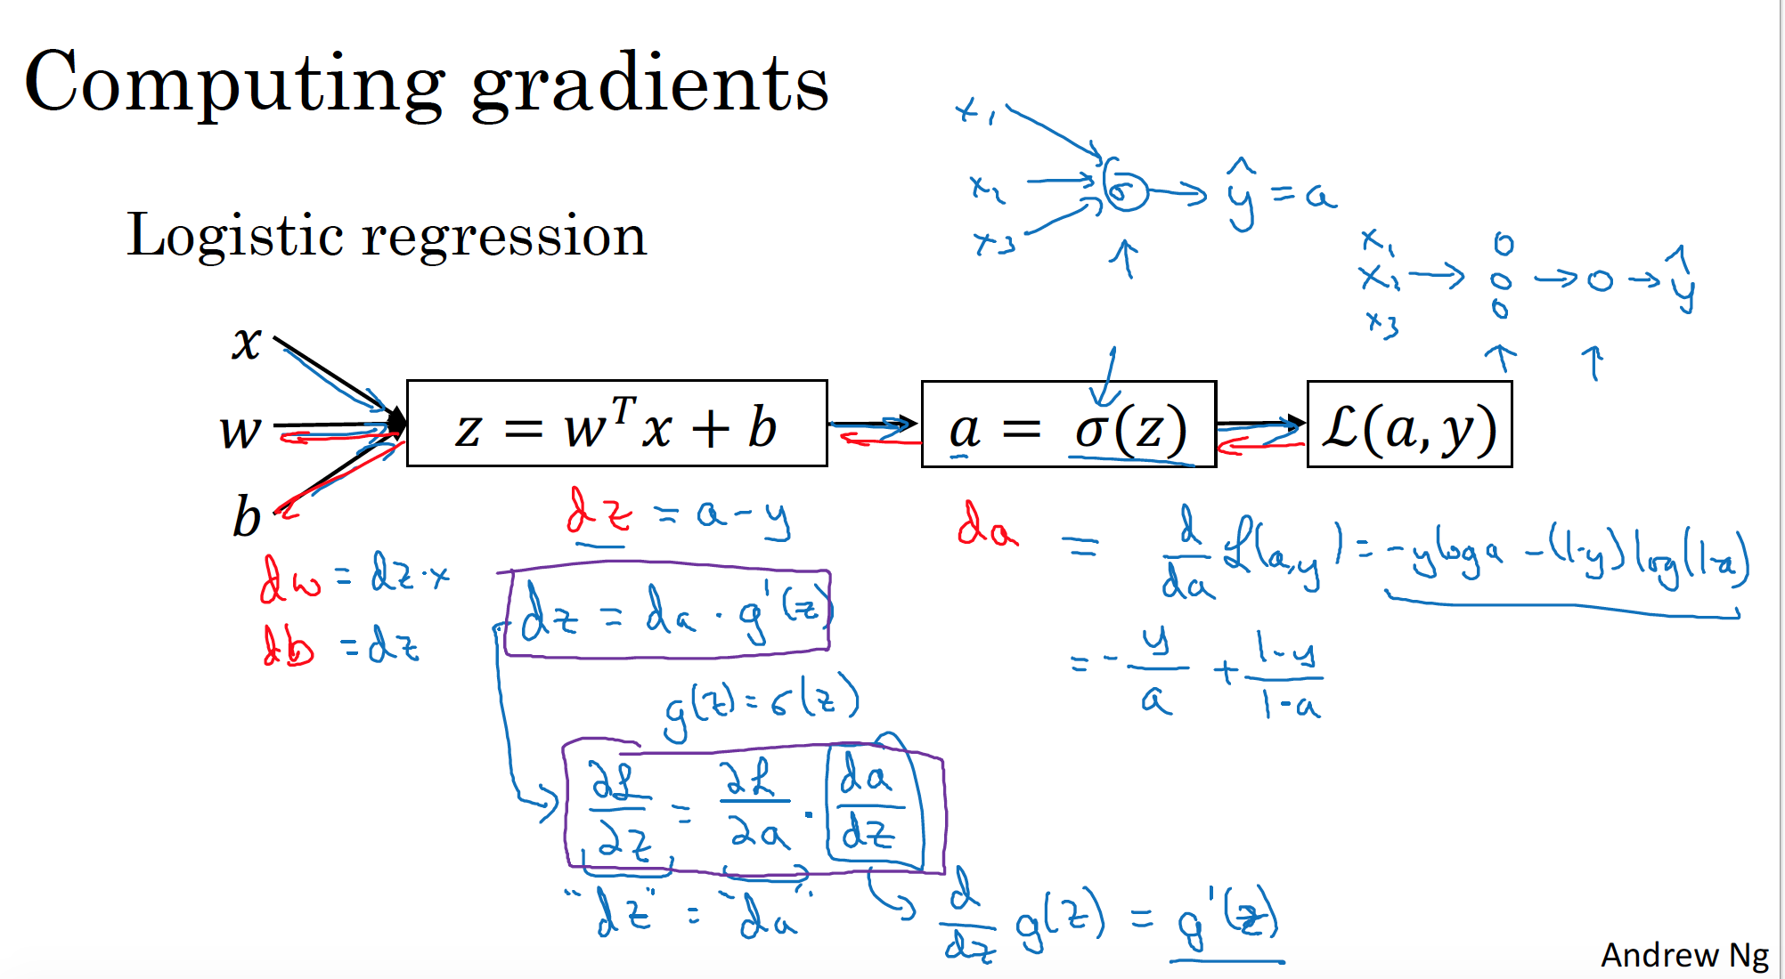

Slide 22
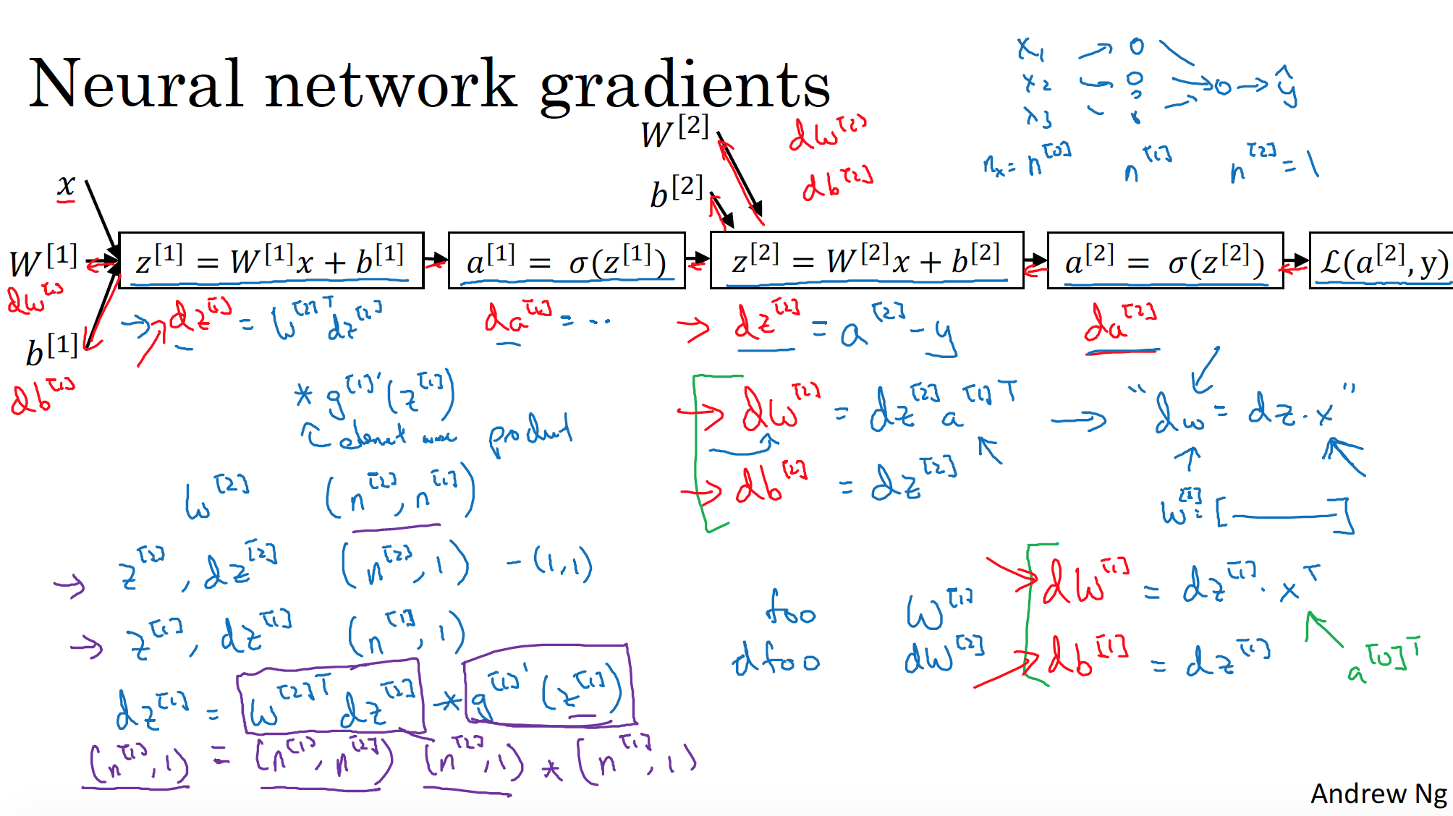

Slide 23
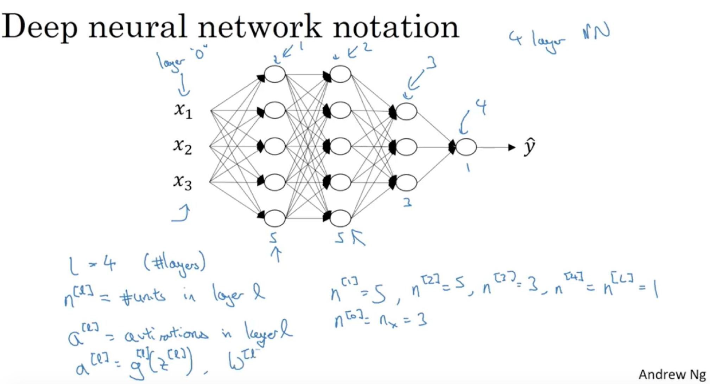

Slide 24
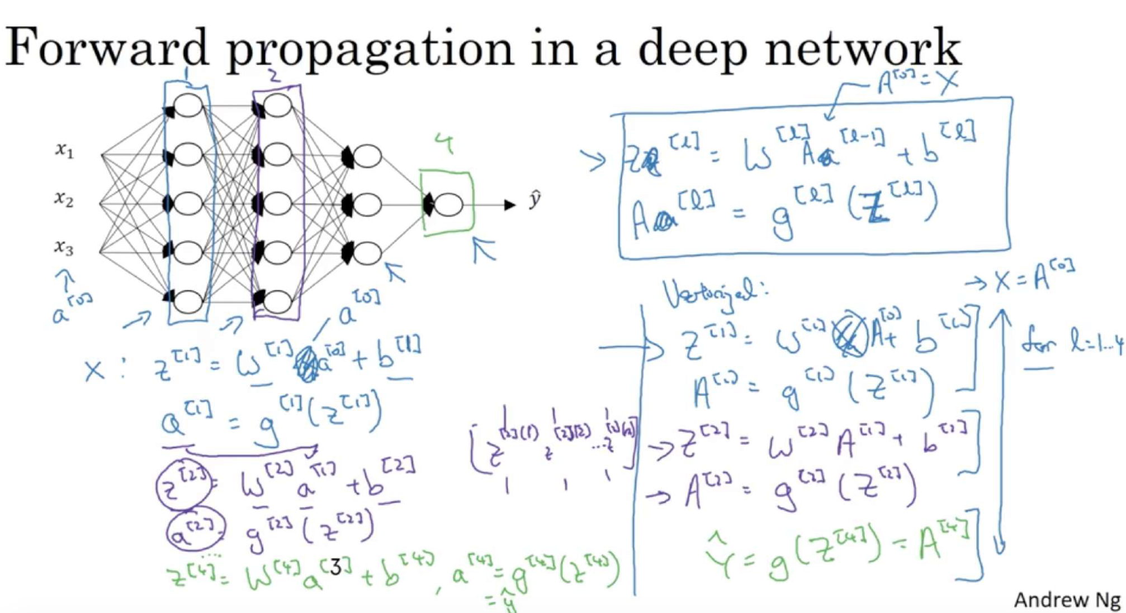

Slide 25
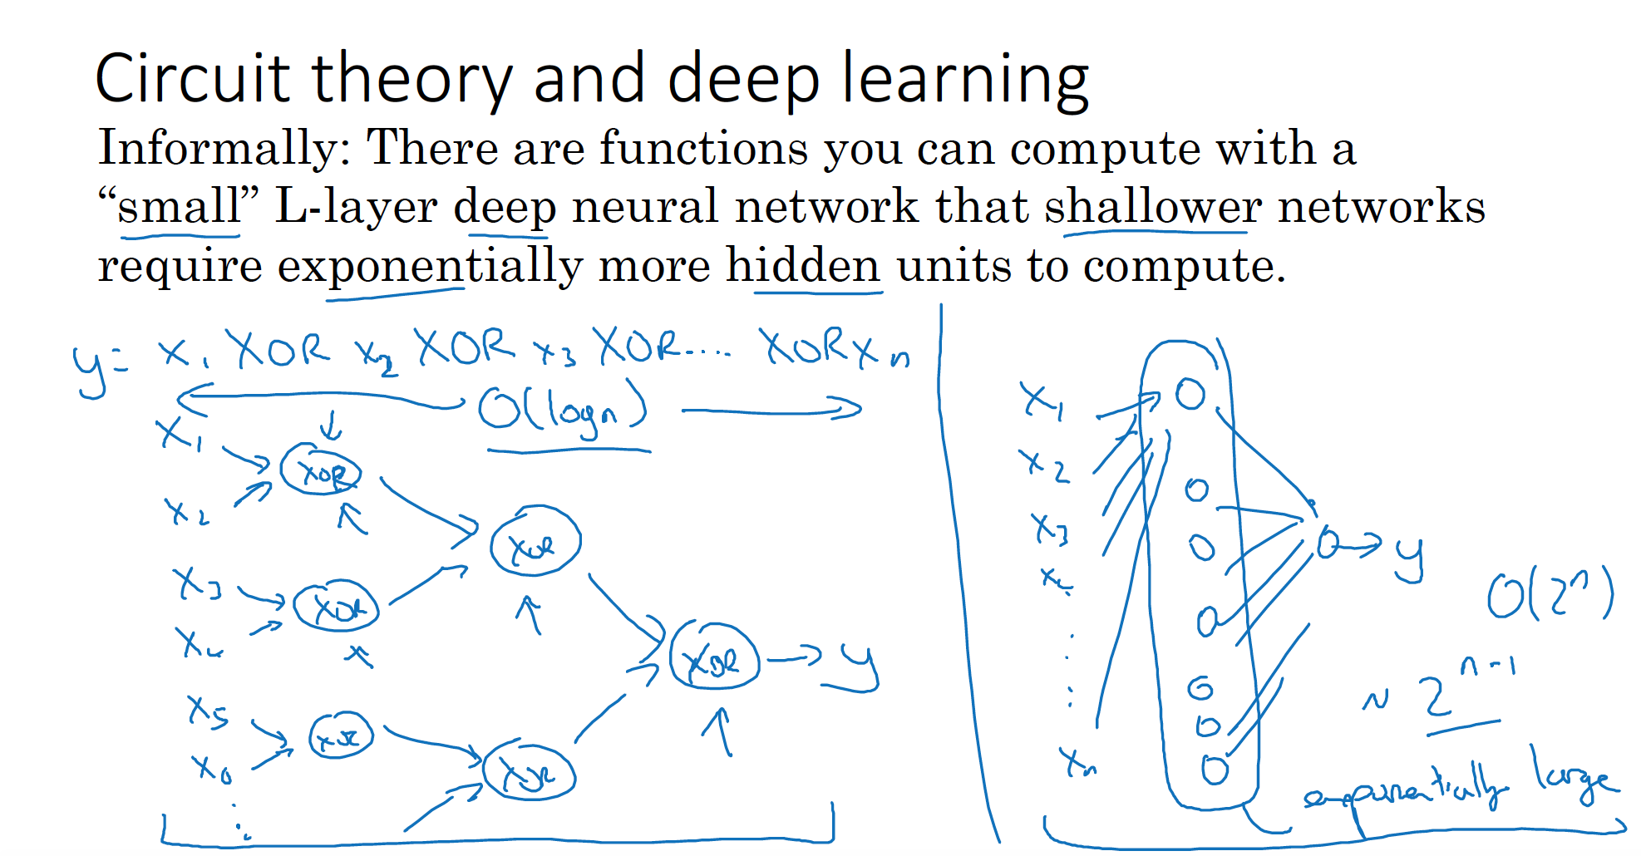

Slide 26
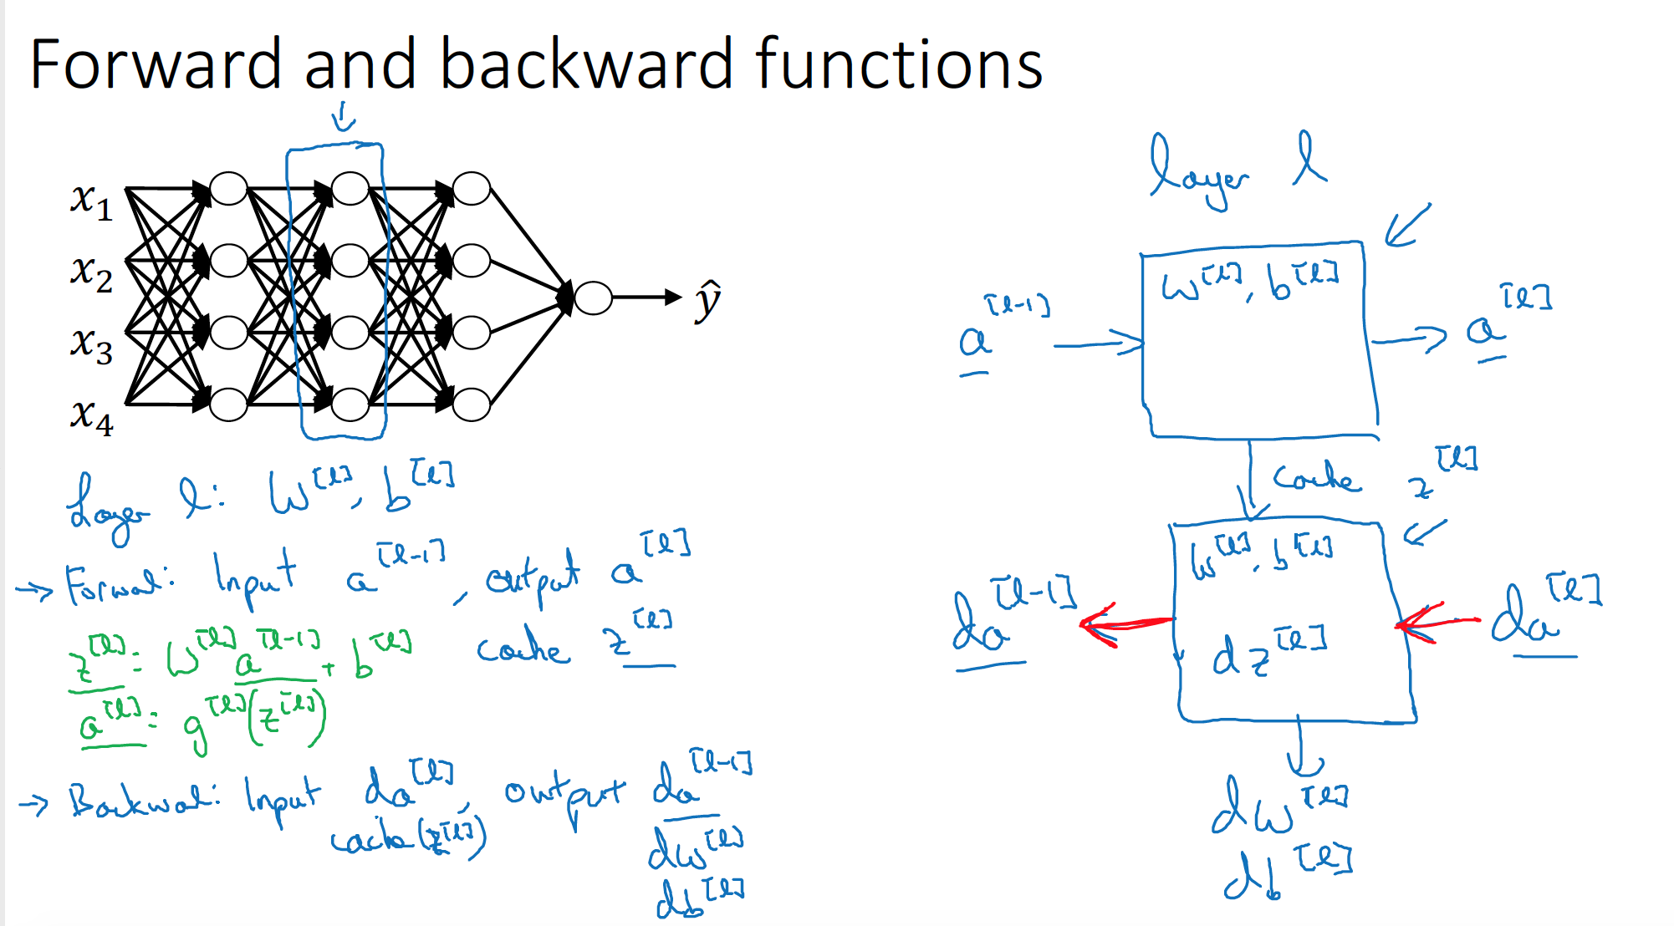

Slide 27
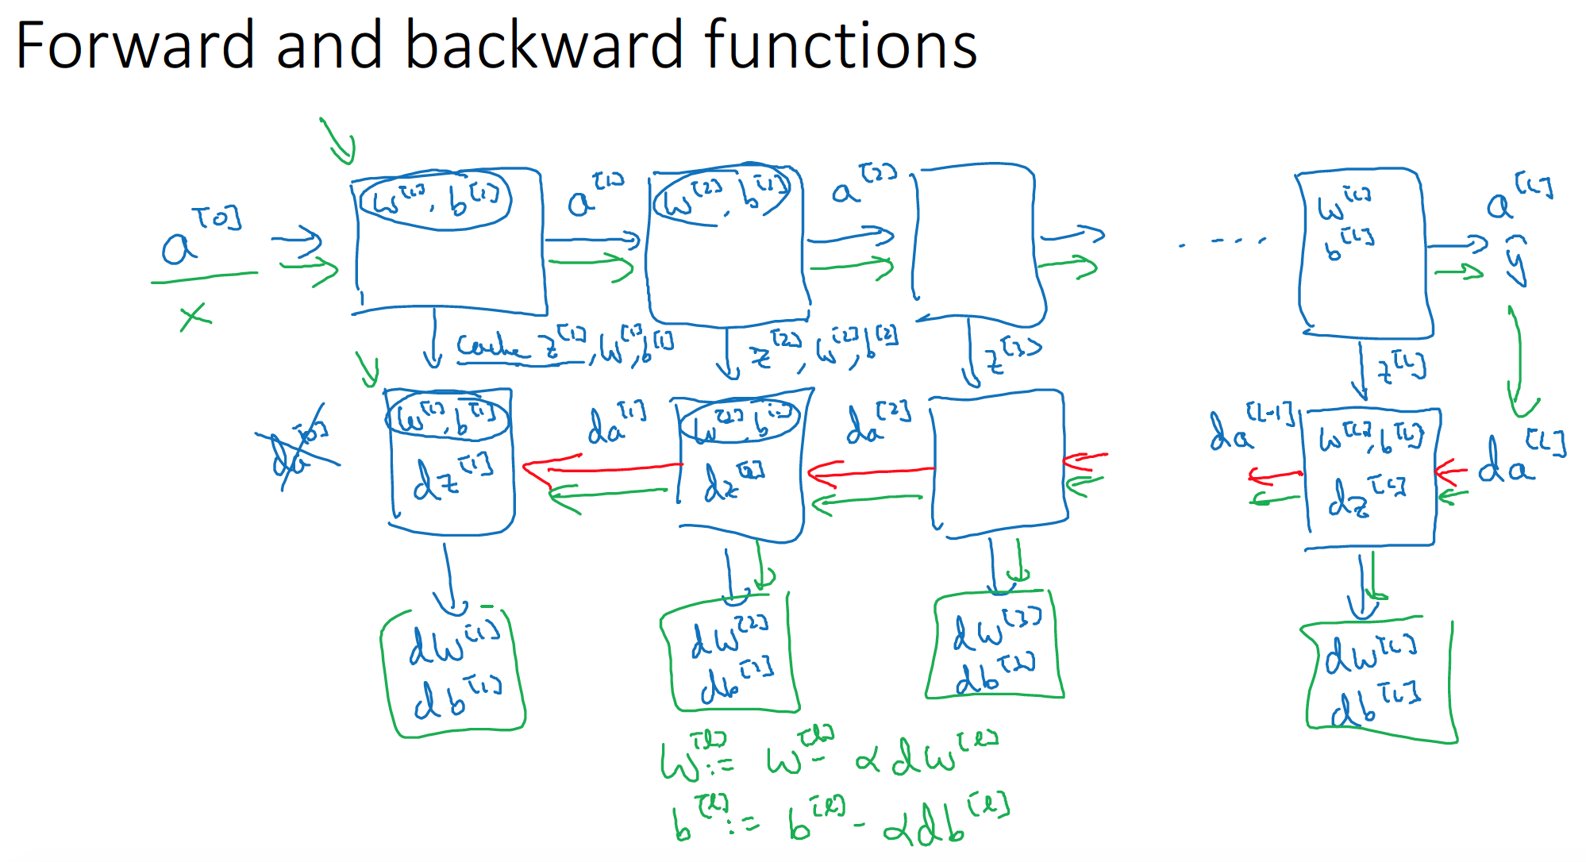

Slide 28
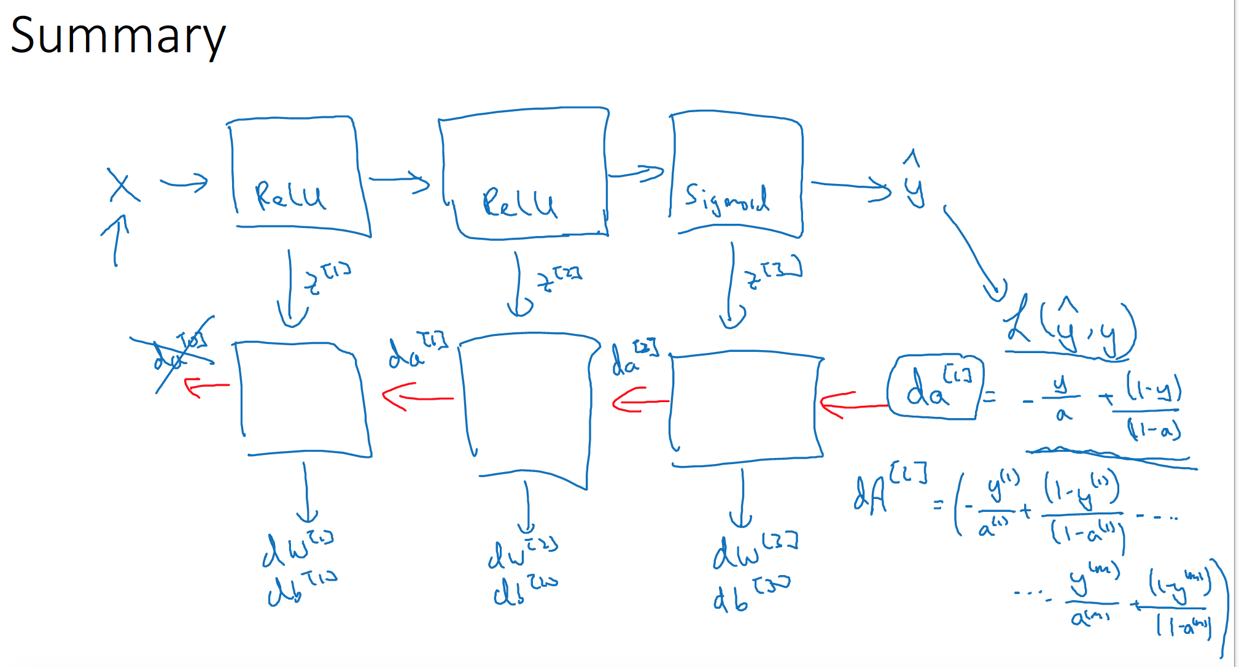

Slide 29
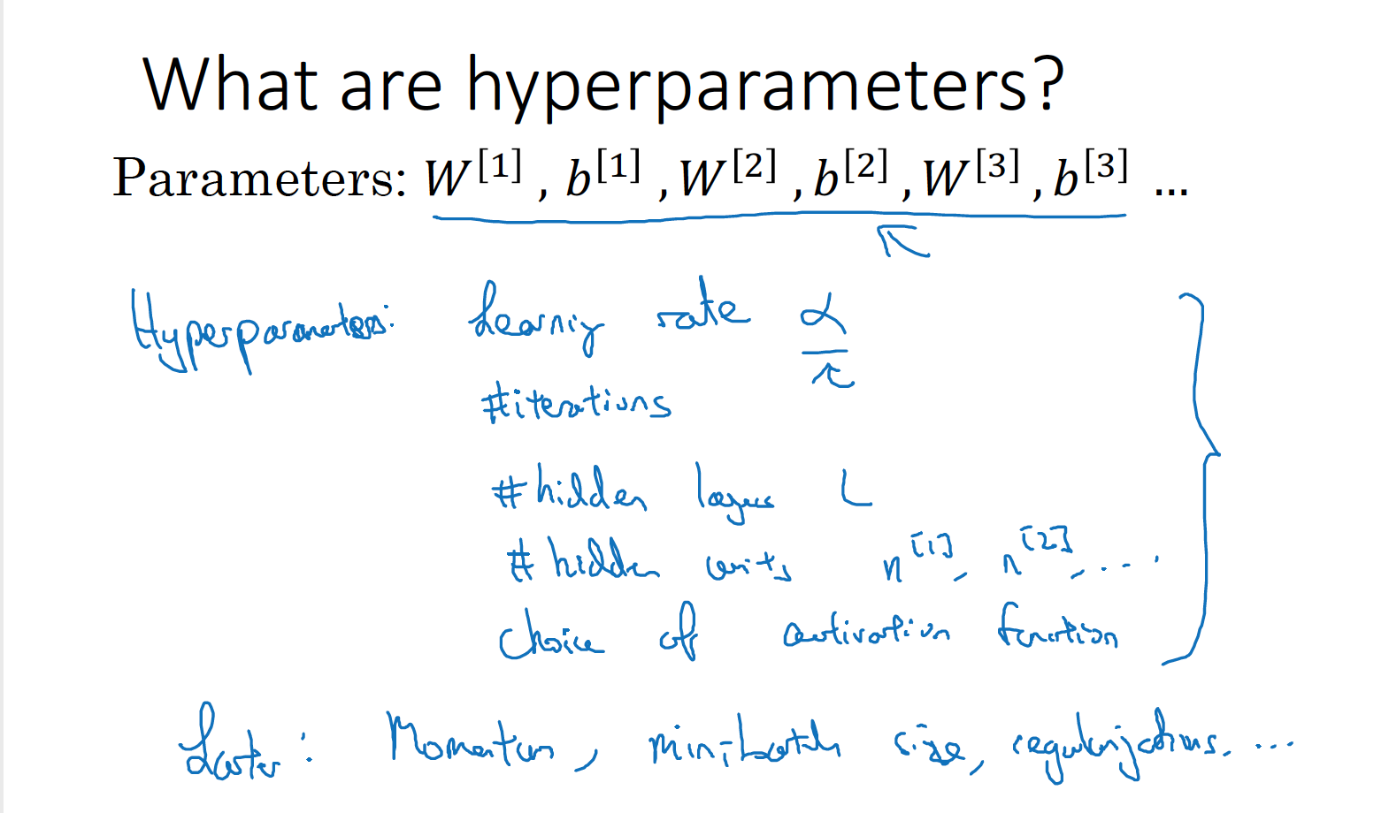

Slide 30
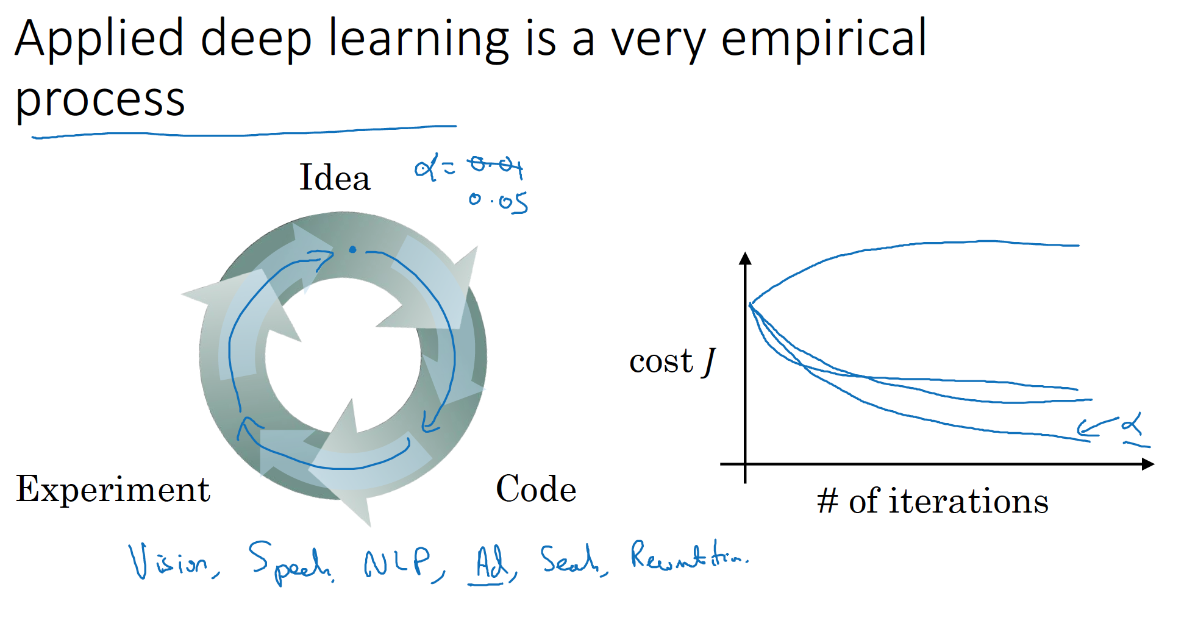

Slide 31
Word Embedding

Slide 32
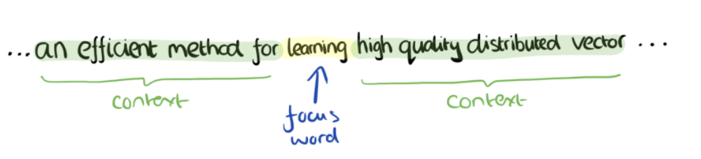

Slide 33
To compare pieces of text
We need effective representation of :
Words
Sentences
Text
Approach 1: Use existing thesauri or ontologies like WordNet and Snomed CT (for medical). Drawbacks:
Manual
Not context specific
Approach 2: Use co-occurrences for word similarity. Drawbacks:
Quadratic space needed
Relative position and order of words not considered

Slide 34
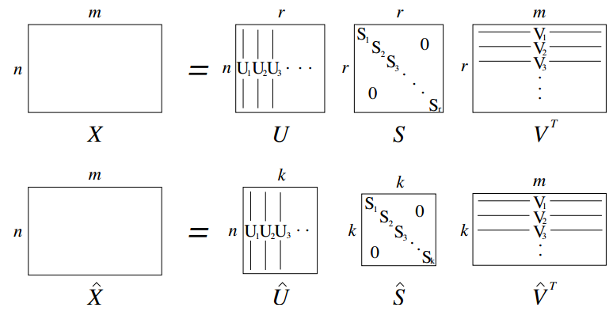
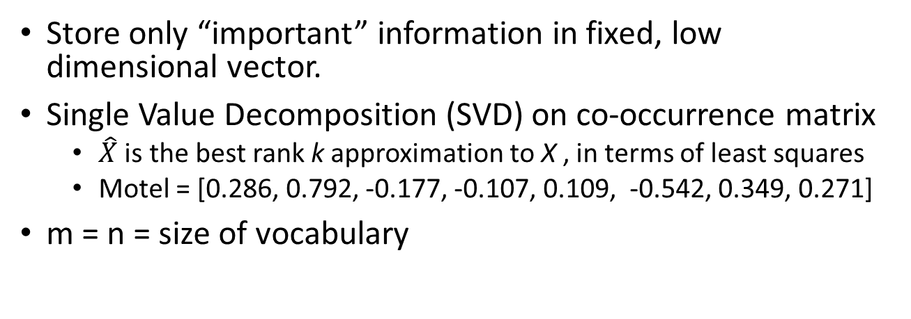
Approach 3: low dimensional vectors
Store only “important” information in fixed, low dimensional vector.
Single Value Decomposition (SVD) on co-occurrence matrix
is the best rank k approximation to X , in terms of least squares
Motel = [0.286, 0.792, -0.177, -0.107, 0.109, -0.542, 0.349, 0.271]
m = n = size of vocabulary

Slide 35
Problems with SVD
Computational cost scales quadratically for n x m matrix: O(mn²) flops (when n<m)
Hard to incorporate new words or documents
Does not consider order of words

Slide 36
word2vec Approach to represent the meaning of word
Represent each word with a low-dimensional vector
Word similarity = vector similarity
Key idea: Predict surrounding words of every word
Faster and can easily incorporate a new sentence/document or add a word to the vocabulary

Slide 37
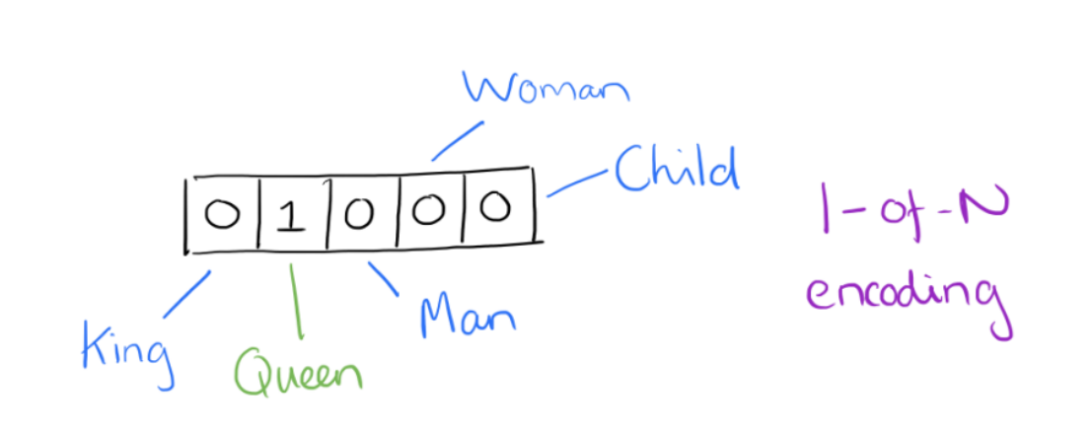
Word2Vec

Slide 38
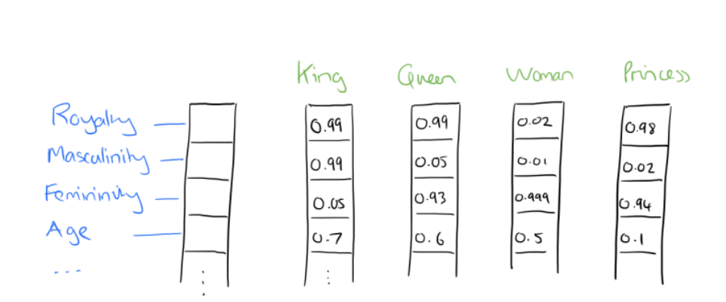
Word2Vec

Slide 39
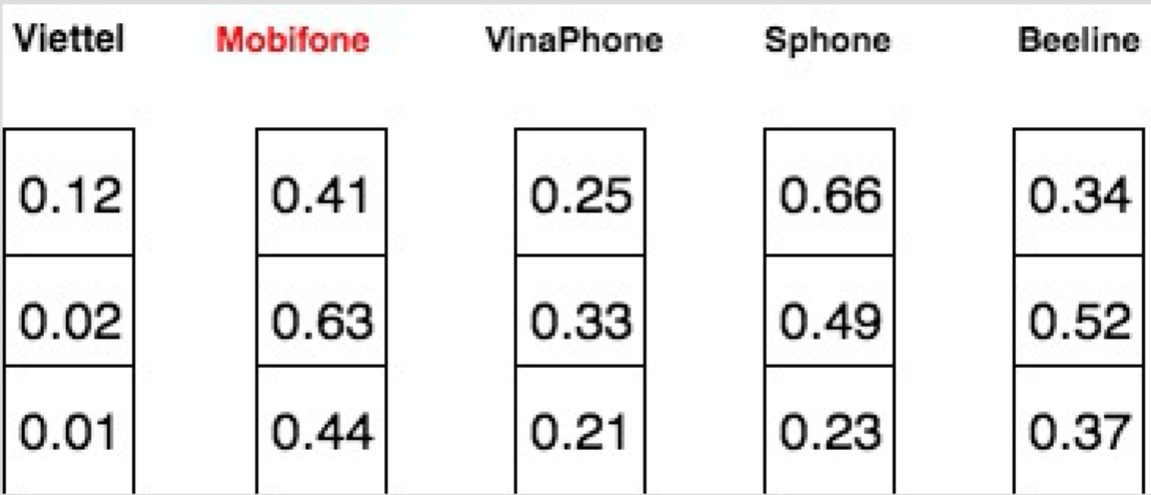
Word2Vec

Slide 40
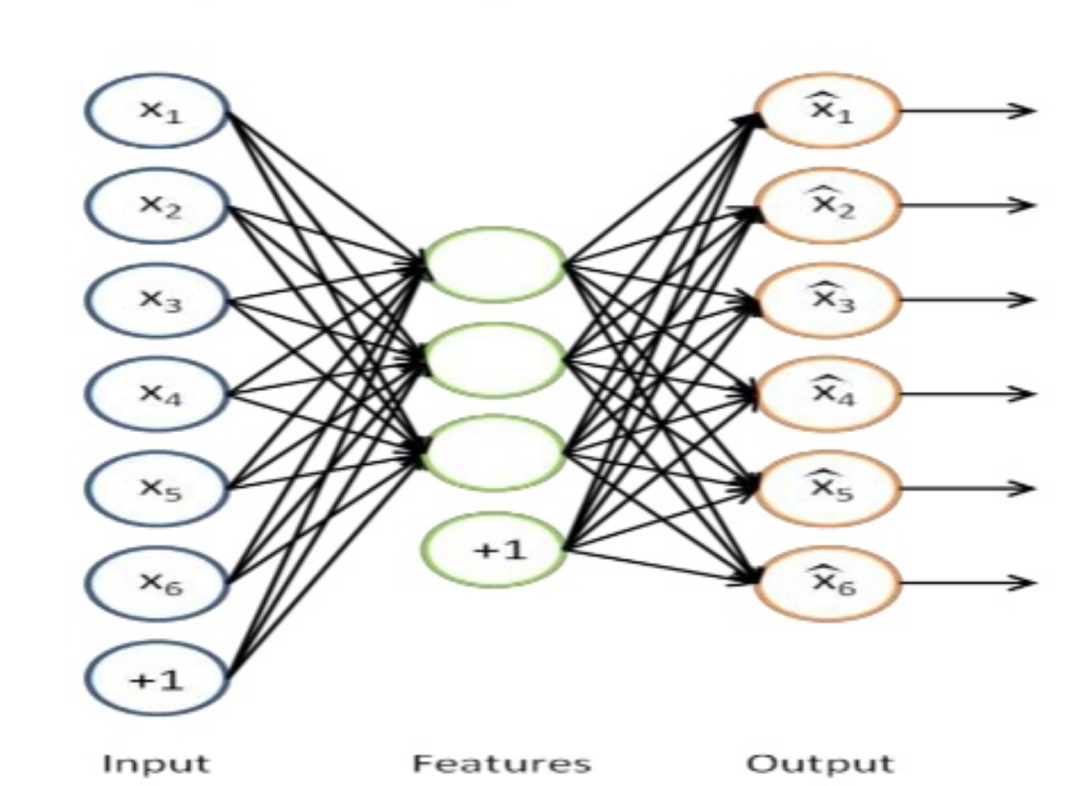
Auto-Encoder

Slide 41
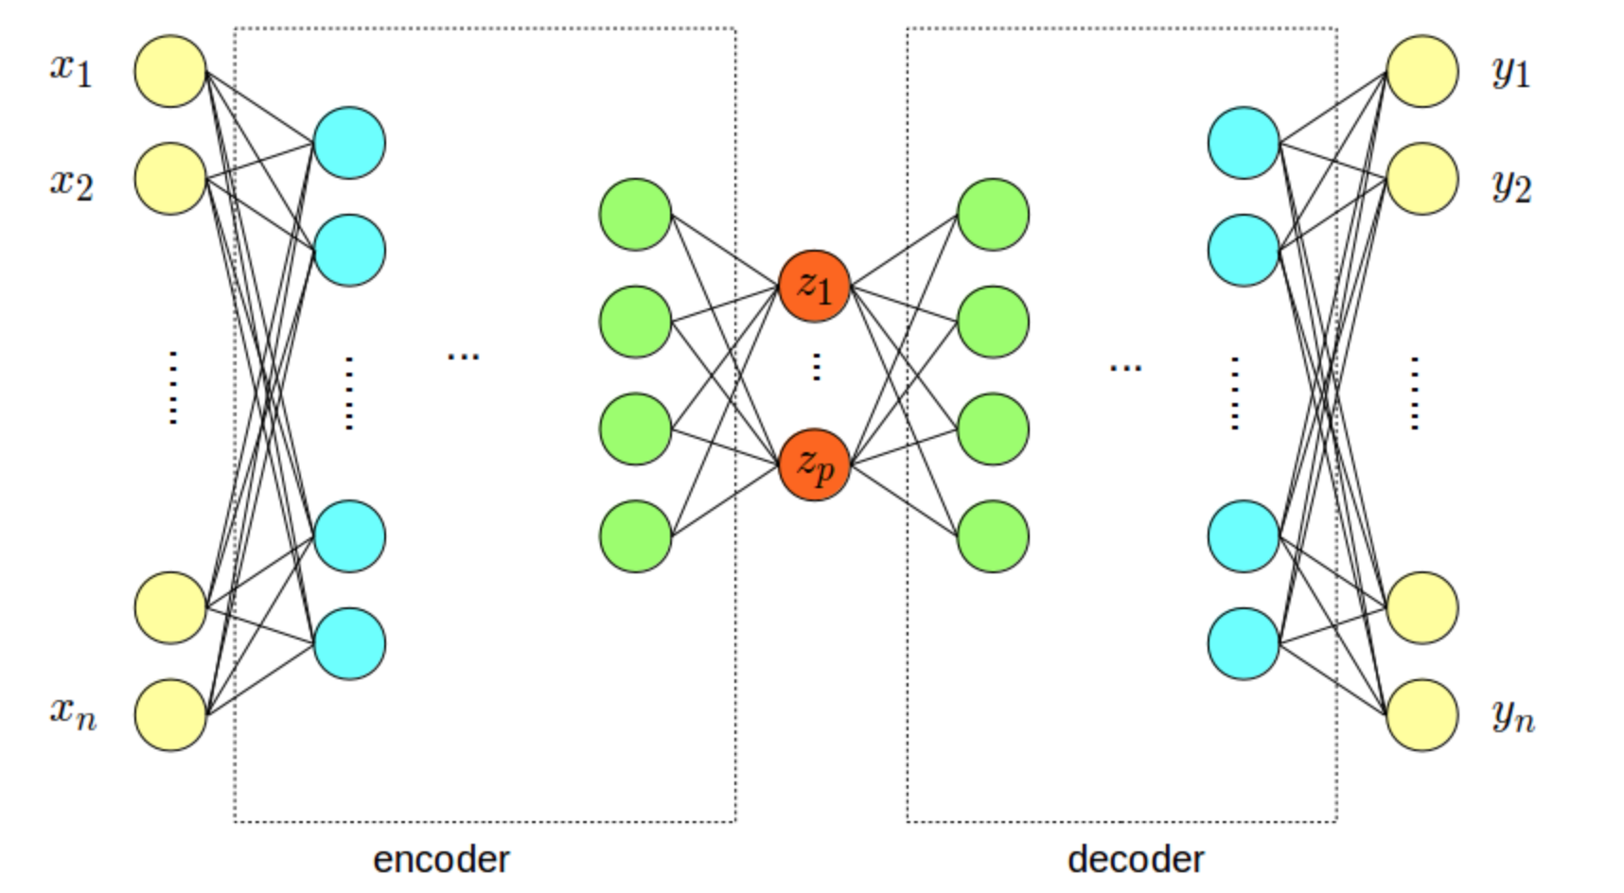
Stacked Auto-Encoder

Slide 42
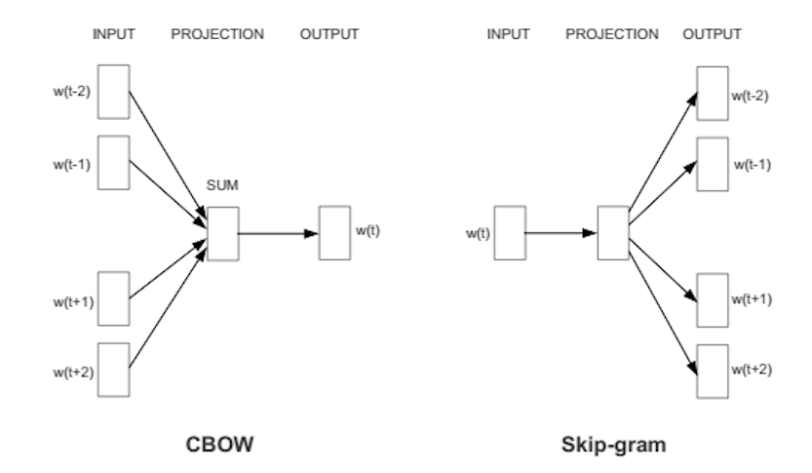
Word2vec

Slide 43
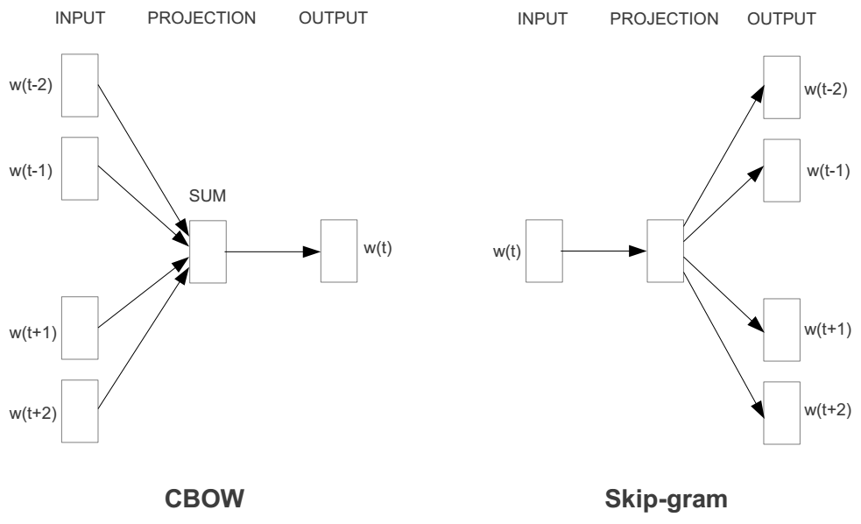
Represent the meaning of word – word2vec
2 basic neural network models:
Continuous Bag of Word (CBOW): use a window of word to predict the middle word
Skip-gram (SG): use a word to predict the surrounding ones in window.

Slide 44
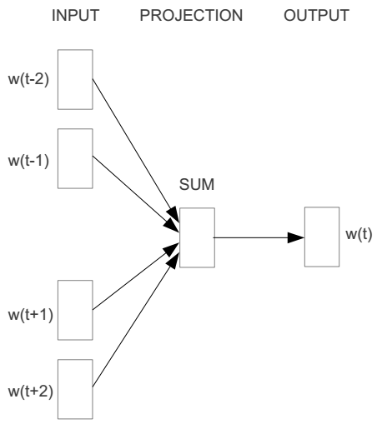
Word2vec – Continuous Bag of Word
E.g. “The cat sat on floor”
Window size = 2
the
cat
sat
on
floor

Slide 45
Input layer
Index of cat in vocabulary
0
1
0
cat
0
Hidden layer
Output layer
0
0
0
0
0
0
…
0
0
0
one-hot
vector
0
sat
one-hot
vector
0
0
0
0
1
0
…
1
0
on
0
0
0
0
…
0

Slide 46
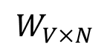
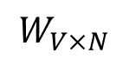
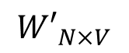
We must learn W and W’
Input layer
0
1
0
cat
0
$$W_{V×N}$$
Hidden layer
Output layer
0
0
0
0
0
0
V-dim
…
0
0
$${W′}_{N×V}$$
0
0
sat
0
0
0
0
1
0
$$W_{V×N}$$
N-dim
…
V-dim
1
0
on
0
0
0
0
V-dim
…
N will be the size of word vector
0

Slide 47
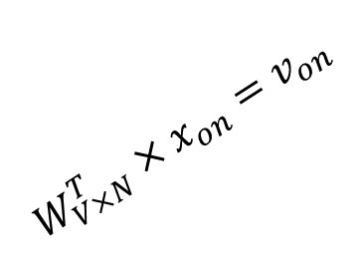
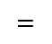
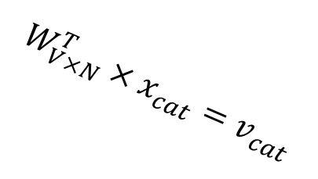
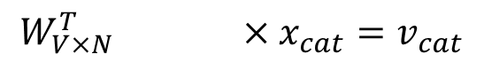
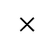
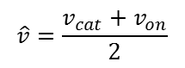
$$W_{V×N}^{T} ×x_{cat}=v_{cat}$$
0.1 | 2.4 | 1.6 | 1.8 | 0.5 | 0.9 | … | … | … | 3.2
0.5 | 2.6 | 1.4 | 2.9 | 1.5 | 3.6 | … | … | … | 6.1
… | … | … | … | … | … | … | … | … | …
… | … | … | … | … | … | … | … | … | …
0.6 | 1.8 | 2.7 | 1.9 | 2.4 | 2.0 | … | … | … | 1.2
0
2.4
2.6
…
…
1.8
Input layer
1
$$×$$
0
$$=$$
0
0
1
0
0
0
x_{cat}
0
0
Output layer
0
0
0
…
$$W_{V×N}^{T}×x_{cat}=v_{cat}$$
0
0
0
0
0
V-dim
…
0
0
$$\hat{v}=\frac{v_{cat}+v_{on}}{2}$$
0
+
0
sat
0
0
0
0
$$W_{V×N}^{T}×x_{on}=v_{on}$$
1
0
…
V-dim
1
Hidden layer
0
x_{on}
0
0
N-dim
0
0
V-dim
…
0

Slide 48
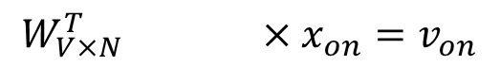
$$W_{V×N}^{T} ×x_{on}=v_{on}$$
0.1 | 2.4 | 1.6 | 1.8 | 0.5 | 0.9 | … | … | … | 3.2
0.5 | 2.6 | 1.4 | 2.9 | 1.5 | 3.6 | … | … | … | 6.1
… | … | … | … | … | … | … | … | … | …
… | … | … | … | … | … | … | … | … | …
0.6 | 1.8 | 2.7 | 1.9 | 2.4 | 2.0 | … | … | … | 1.2
0
1.8
2.9
…
…
1.9
Input layer
0
$$×$$
0
$$=$$
0
1
1
0
0
0
x_{cat}
0
0
Output layer
0
0
0
…
$$W_{V×N}^{T}×x_{cat}=v_{cat}$$
0
0
0
0
0
V-dim
…
0
0
$$\hat{v}=\frac{v_{cat}+v_{on}}{2}$$
0
+
0
sat
0
0
0
0
$$W_{V×N}^{T}×x_{on}=v_{on}$$
1
0
…
V-dim
1
Hidden layer
0
x_{on}
0
0
N-dim
0
0
V-dim
…
0

Slide 49






Input layer
0
1
0
cat
0
$$W_{V×N}$$
Hidden layer
Output layer
0
0
0
0
0
0
V-dim
…
0
0
$$W_{V×N}^{′}×\hat{v}=z$$
0
$$\hat{y}=softmax(z)$$
0
0
0
0
0
$$\hat{v}$$
1
0
$$W_{V×N}$$
…
1
N-dim
0
on
0
${\hat{y}}_{sat}$
0
0
V-dim
0
V-dim
…
N will be the size of word vector
0

Slide 50



Input layer
0
We would prefer $\hat{y}$ close to ${\hat{y}}_{sat}$
1
0
cat
0
$$W_{V×N}$$
Hidden layer
Output layer
0
0
0
0
0.01
0.02
0.00
0.02
0.01
0.02
0.01
0.7
…
0.00
0
0
V-dim
…
0
0
$$W_{V×N}^{′}×\hat{v}=z$$
$$\hat{y}=softmax(z)$$
0
0
0
0
0
0
$$\hat{v}$$
1
0
$$W_{V×N}$$
…
1
N-dim
0
on
0
${\hat{y}}_{sat}$
0
0
V-dim
0
V-dim
…
N will be the size of word vector
$\hat{y}$
0

Slide 51




$$W_{V×N}^{T}$$
0.1 | 2.4 | 1.6 | 1.8 | 0.5 | 0.9 | … | … | … | 3.2
0.5 | 2.6 | 1.4 | 2.9 | 1.5 | 3.6 | … | … | … | 6.1
… | … | … | … | … | … | … | … | … | …
… | … | … | … | … | … | … | … | … | …
0.6 | 1.8 | 2.7 | 1.9 | 2.4 | 2.0 | … | … | … | 1.2
Contain word’s vectors
Input layer
0
1
0
x_{cat}
0
Output layer
0
0
$$W_{V×N}^{}$$
0
0
0
0
V-dim
…
0
0
$$W_{V×N}^{′}$$
0
0
sat
0
0
0
0
1
0
$$W_{V×N}^{}$$
…
1
0
V-dim
x_{on}
0
Hidden layer
0
N-dim
0
0
V-dim
…
0
We can consider either W or W’ as the word’s representation. Or even take the average.
Notes:
W contains input word vectors.
W’ contains output word vectors.
We can consider either W or W’ as the word’s representation. Or even take the average.

Slide 52

Some interesting results

Slide 53

Word analogies

Slide 54
Combination of tf.idf and WE
Recall
Doc = {tfidf1, tfidf2,…,tfidf_t}
W1 = {x11,x12,…, x_t}
…
Wt = {xt1,xt2,…, x_tt}
Then d_1 = W1*tfidf1, d_2 = W2*tfidf2,… etc
Finally DocVect = average of all d_i

